Slide 1
Organic Shop
Project

Slide 2

Overview
Introduction
Purpose and Objectives
Challenges in the Organic Market and Our Solutions
Technologies Used Requirements
Goals
Wireframe Diagram
Application Overview

Slide 3

Introduction
An organic shop typically refers to a retail establishment that specializes in selling organic products. These products are sourced from organic farming methods, which emphasize sustainable practices, natural fertilizers, and avoiding synthetic chemicals, pesticides, and genetically modified organisms (GMO)

Slide 4
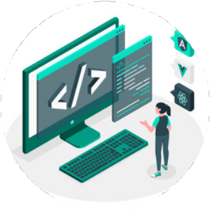



Technologies used
Software development technologies are the tools and methods that developers use to design, develop, test, and deploy software applications
HTML,CSS,JAVASCRIPT, BOOTSTRAP,REACTJS
MYSQL DATABASE
Frontend
Database
C#, DOTNET FRAMEWORK
SELENIUM
Testing
Backend

Slide 5
Requirements
Hardware Requirements:
8 GB RAM
Integrated Graphics / External graphics card
Software Requirements:
VS Code
Visual Studio
Eclipse
4) MySQL Installer

Slide 6





Goals
Our mission is to provide fresh, organic, and sustainably sourced products that nourish both the body and the planet. We aim to create an environment where our customers can shop with confidence, knowing they are supporting eco-friendly practices and local farmers.
01 02 03
Pure and organics
Distribution
Responsive Design
Our goal is to deliver premium organic products while supporting sustainable farming practices that preserve soil health and biodiversity.
We partner with local farmers to bring fresh, chemical-free foods directly to your table.
Our goal is to streamline the organic supply chain by connecting small- scale organic farmers with retail partners through our innovative distribution network. We aim to reduce food waste while ensuring fair prices for producers.
Site speed and design are two of the most important ranking factors that Google takes into consideration, as they have a significant effect on customer engagement and behavior, with faster websites being more likely to keep visitors on the site.

Slide 7
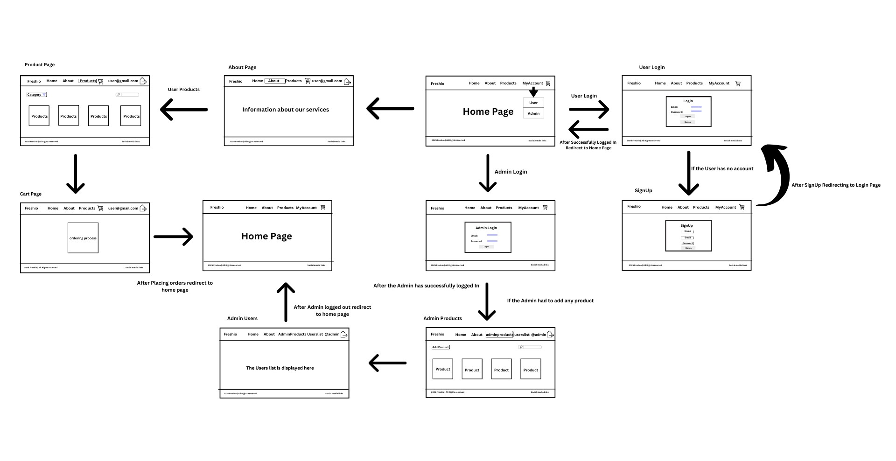
WireFrame Diagram

Slide 8

APPLICATION OVERVIEW

Slide 9
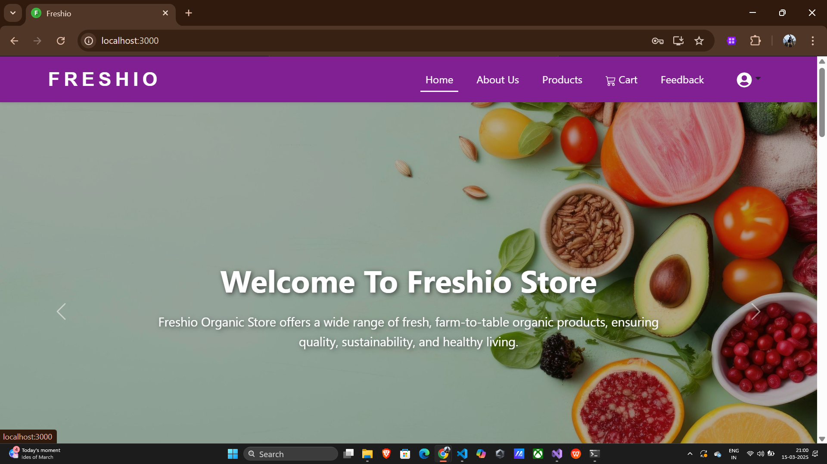
LANDING PAGE

Slide 10
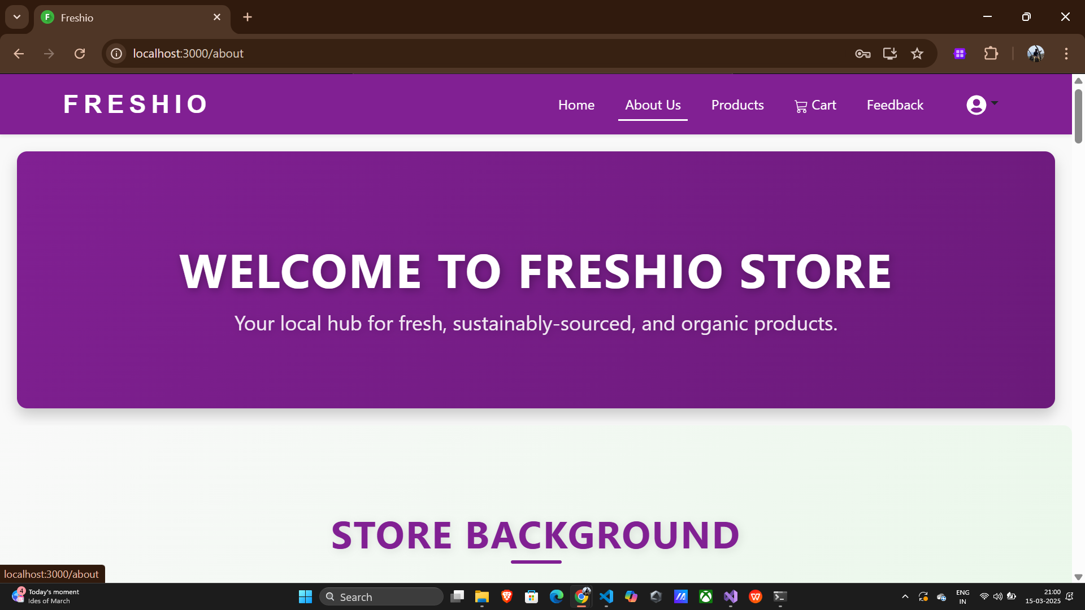
ABOUT PAGE

Slide 11
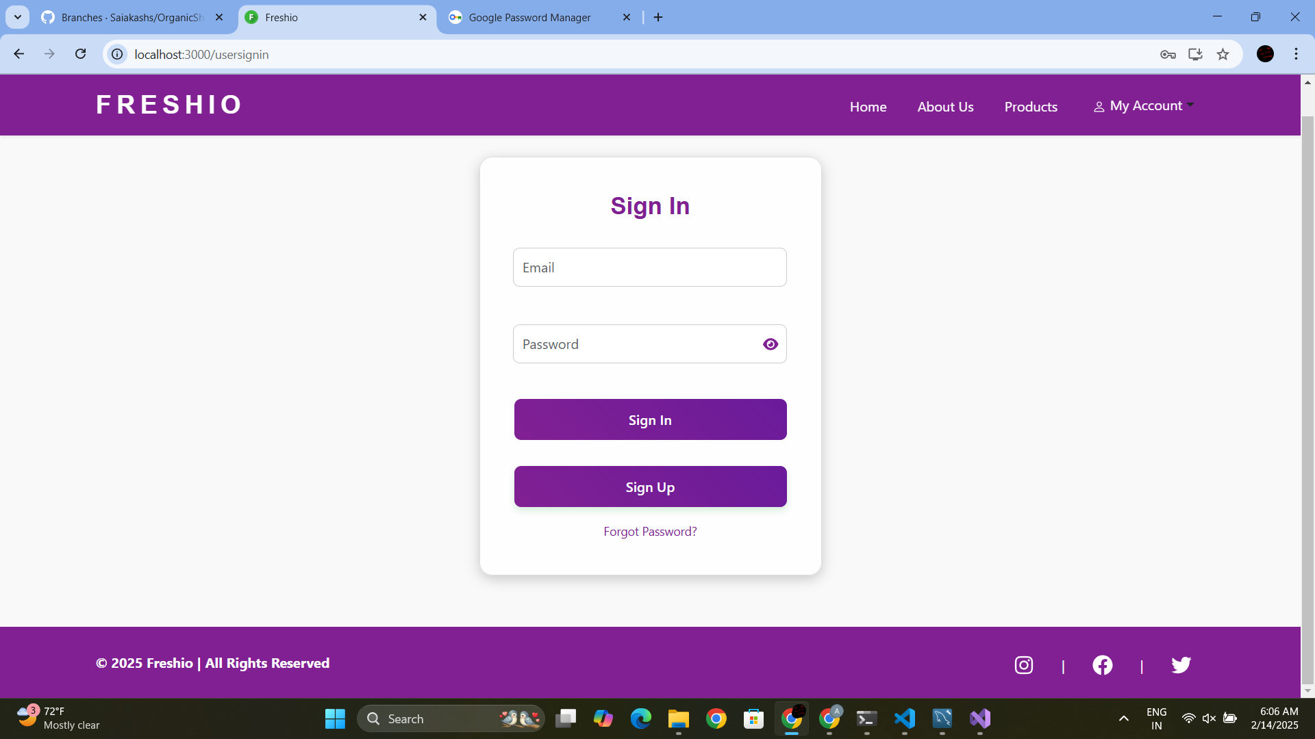
SIGN IN PAGE

Slide 12
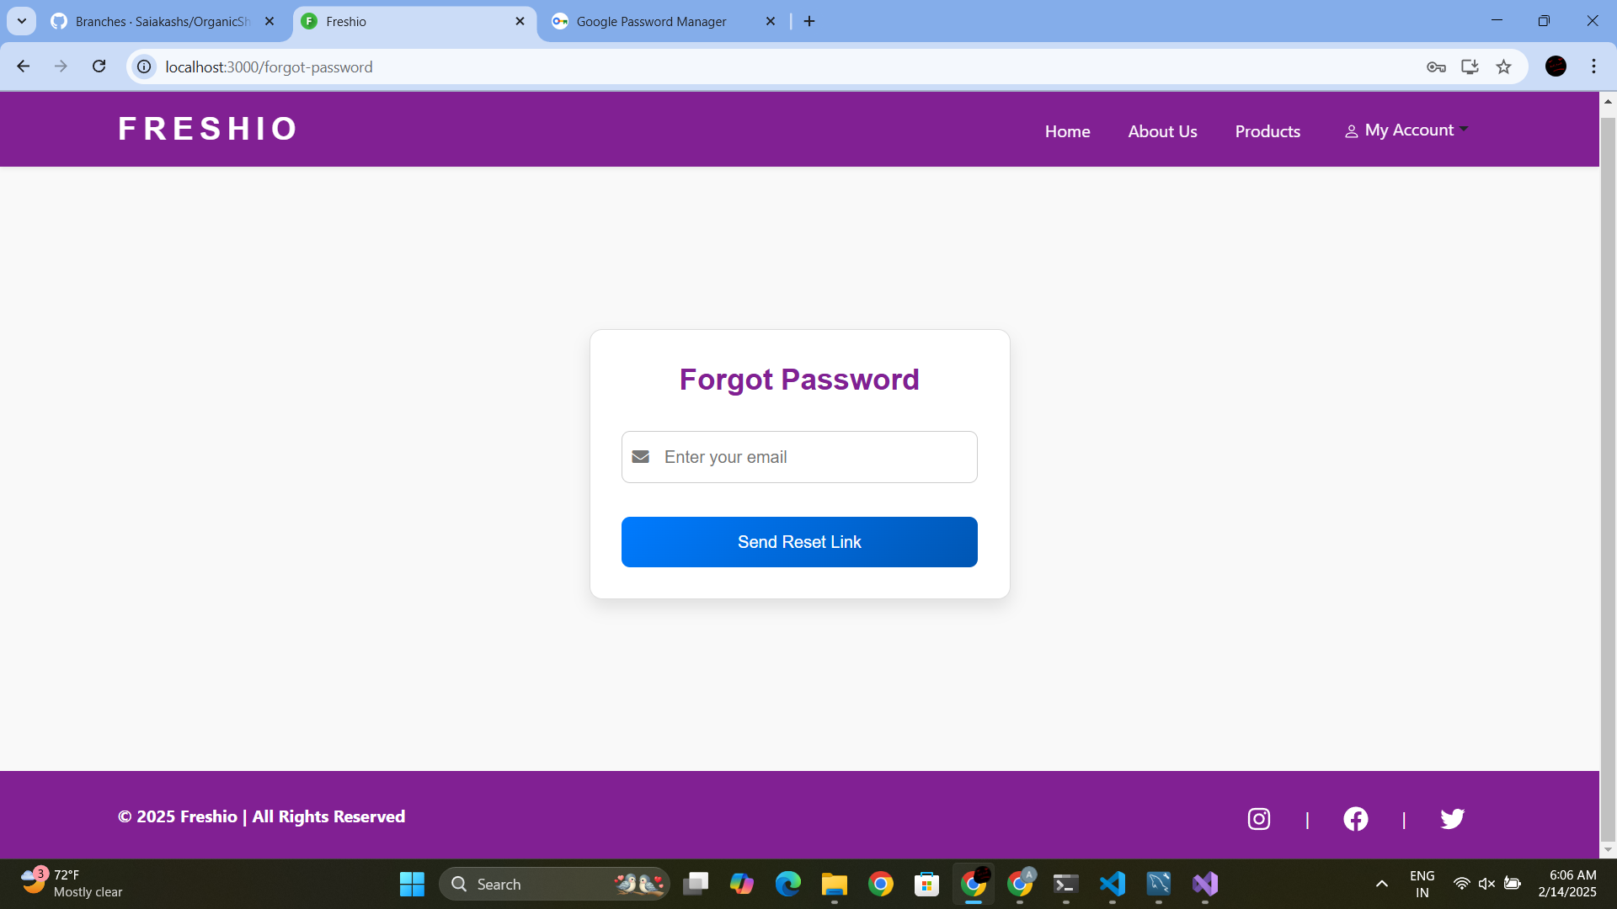
FORGET PASSWORD PAGE

Slide 13
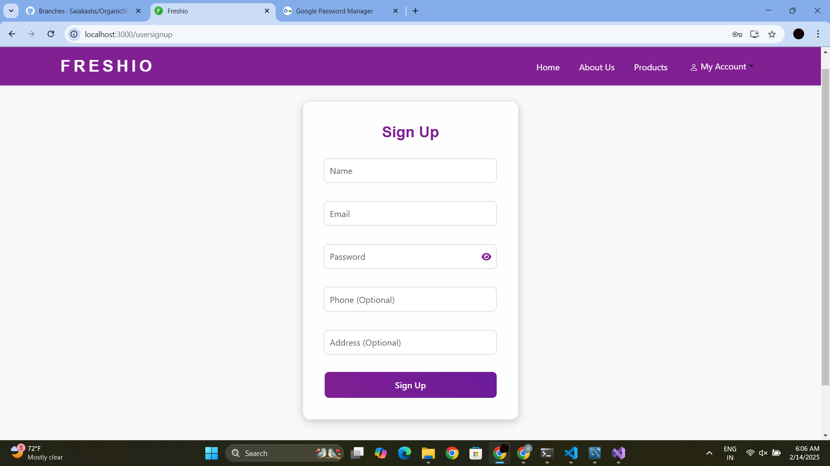
SIGNUP PAGE

Slide 14
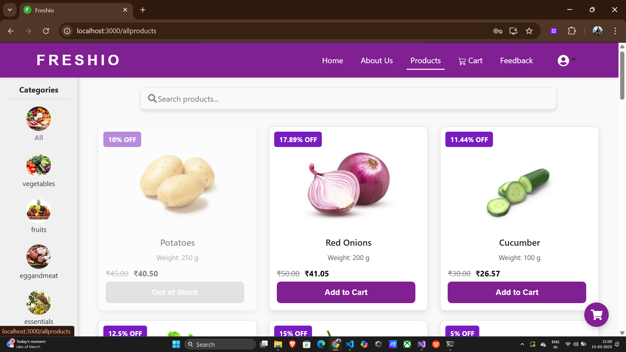
PRODUCTS PAGE

Slide 15
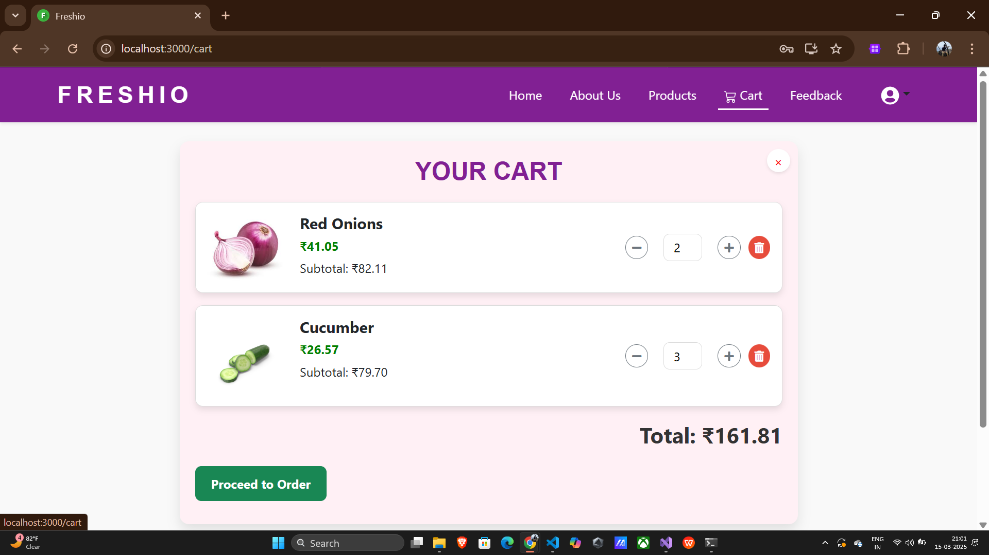
CART PAGE

Slide 16
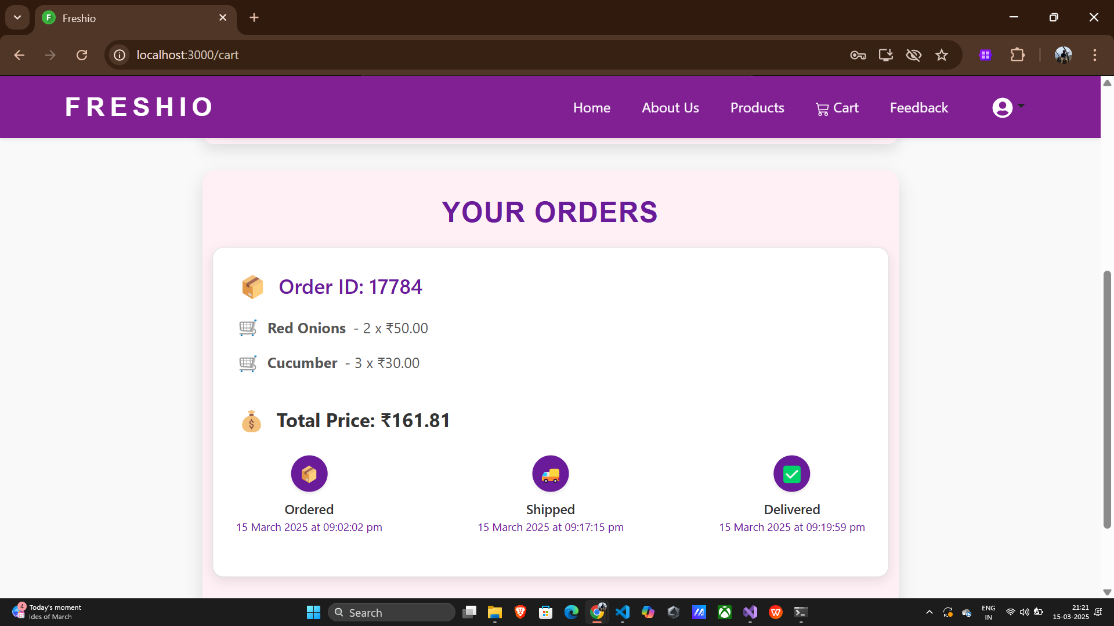
SHIPMENT TRACKING

Slide 17
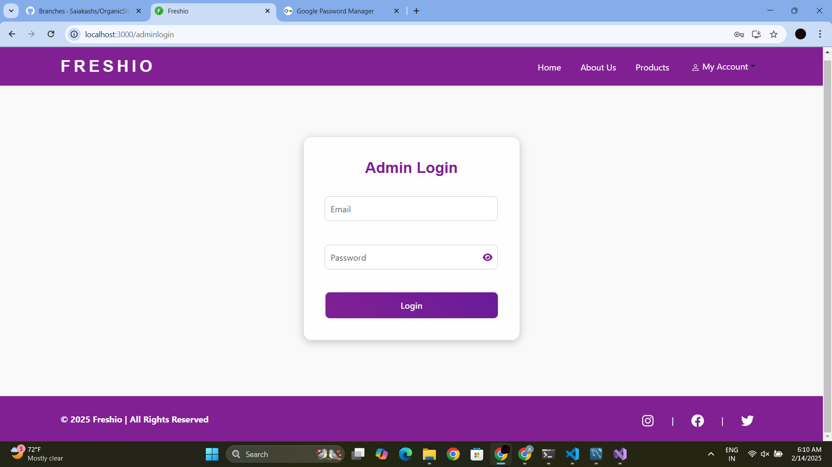
ADMIN LOGIN

Slide 18
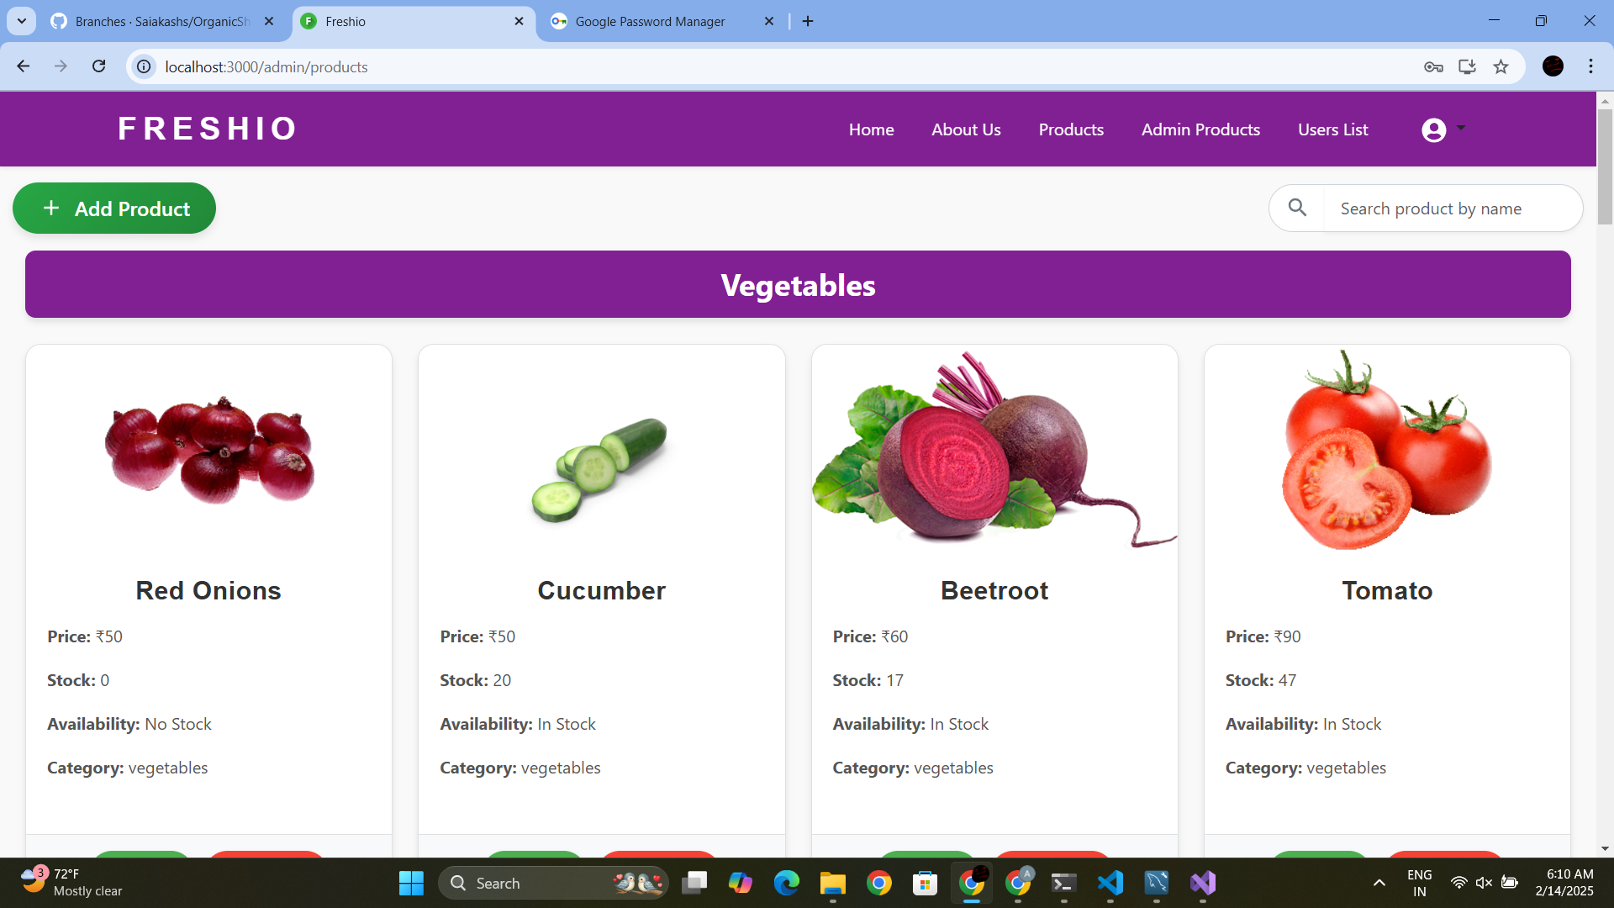
ADMIN PRODUCTS PAGE

Slide 19
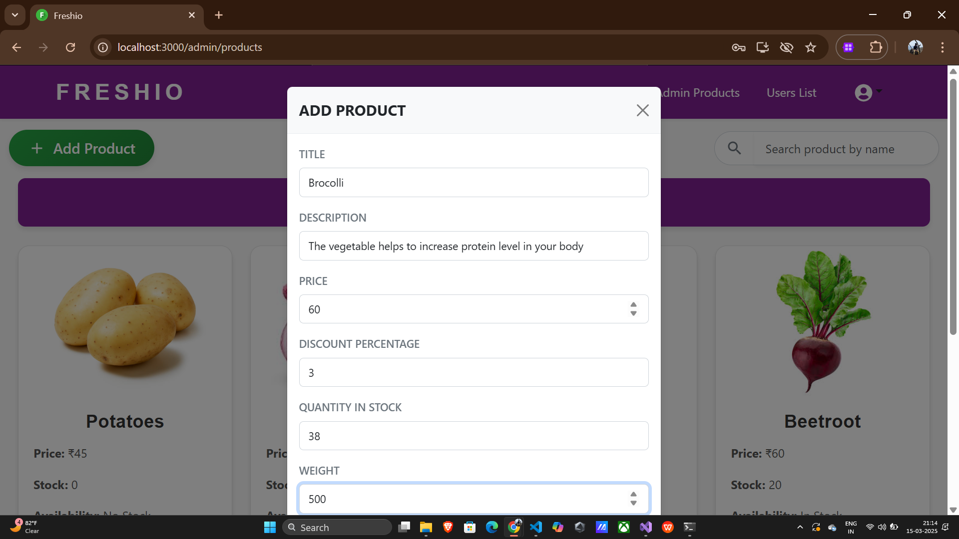
Admin Edit Product

Slide 20
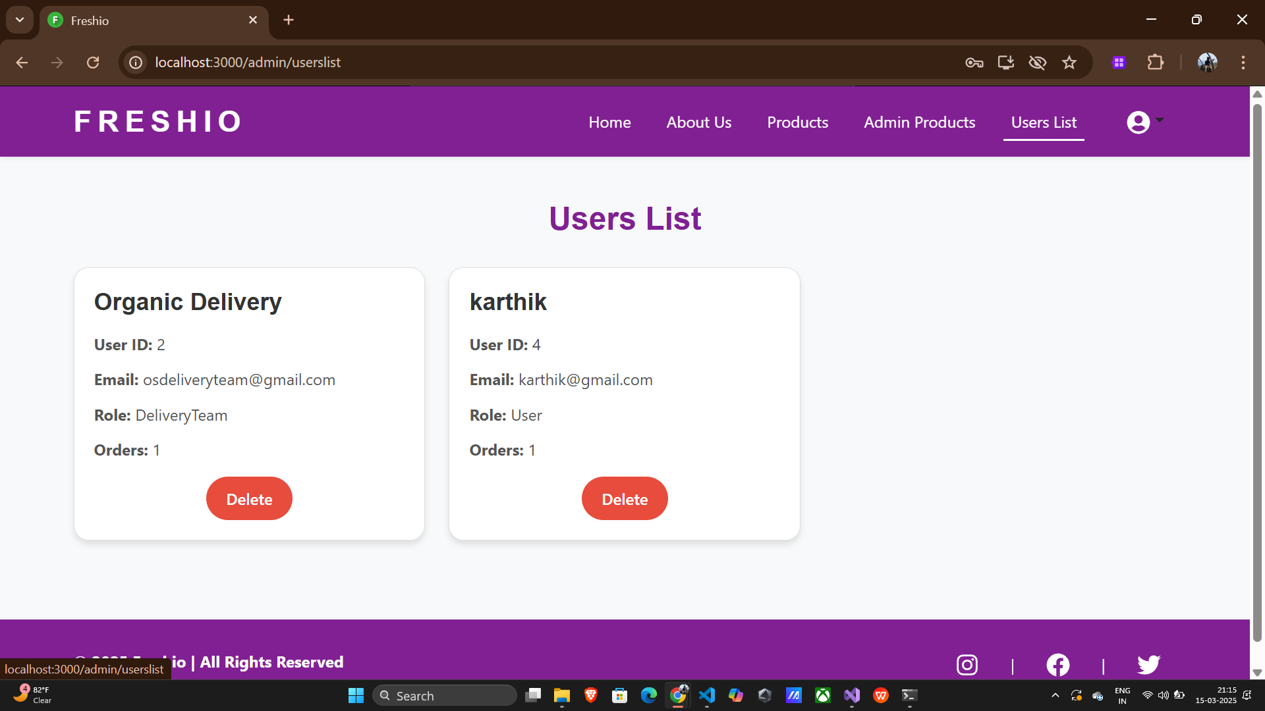
ADMIN USER PAGE

Slide 21

Delivery Team Login Page

Slide 22
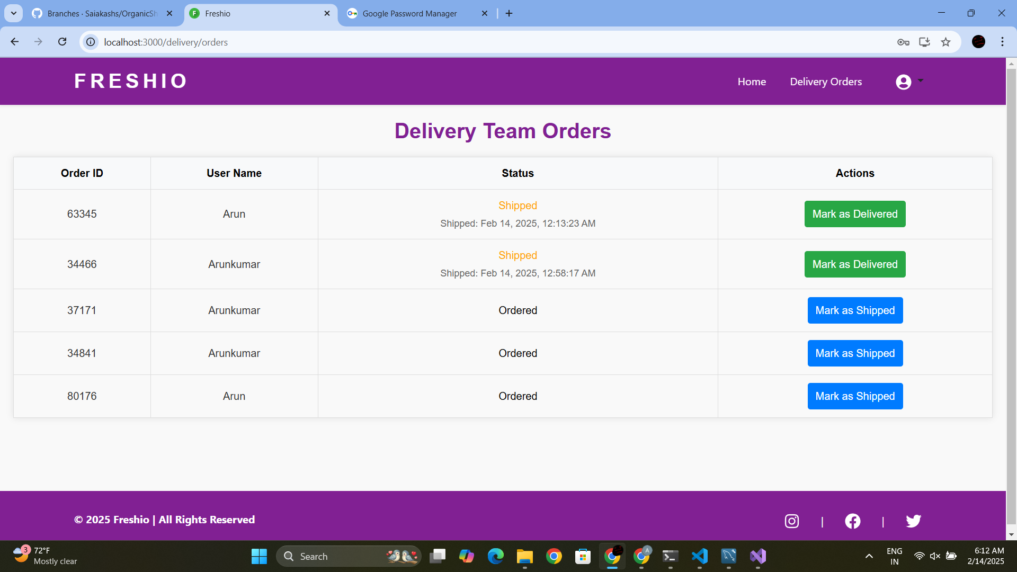
Delivery Team Orders Page

Slide 23
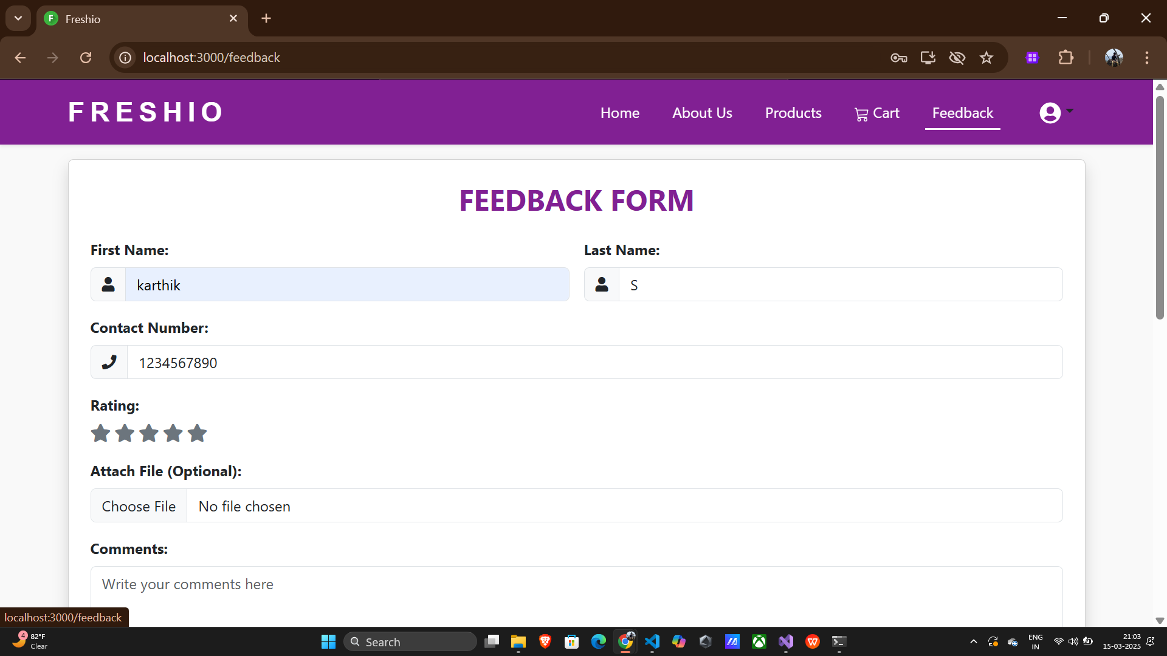
FEEDBACK PAGE

Slide 24
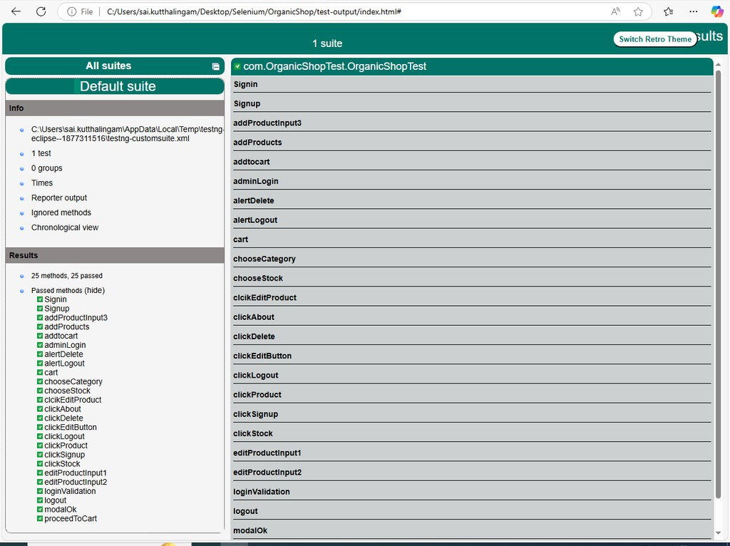
SELENIUM REPORT
TestNG

Slide 25
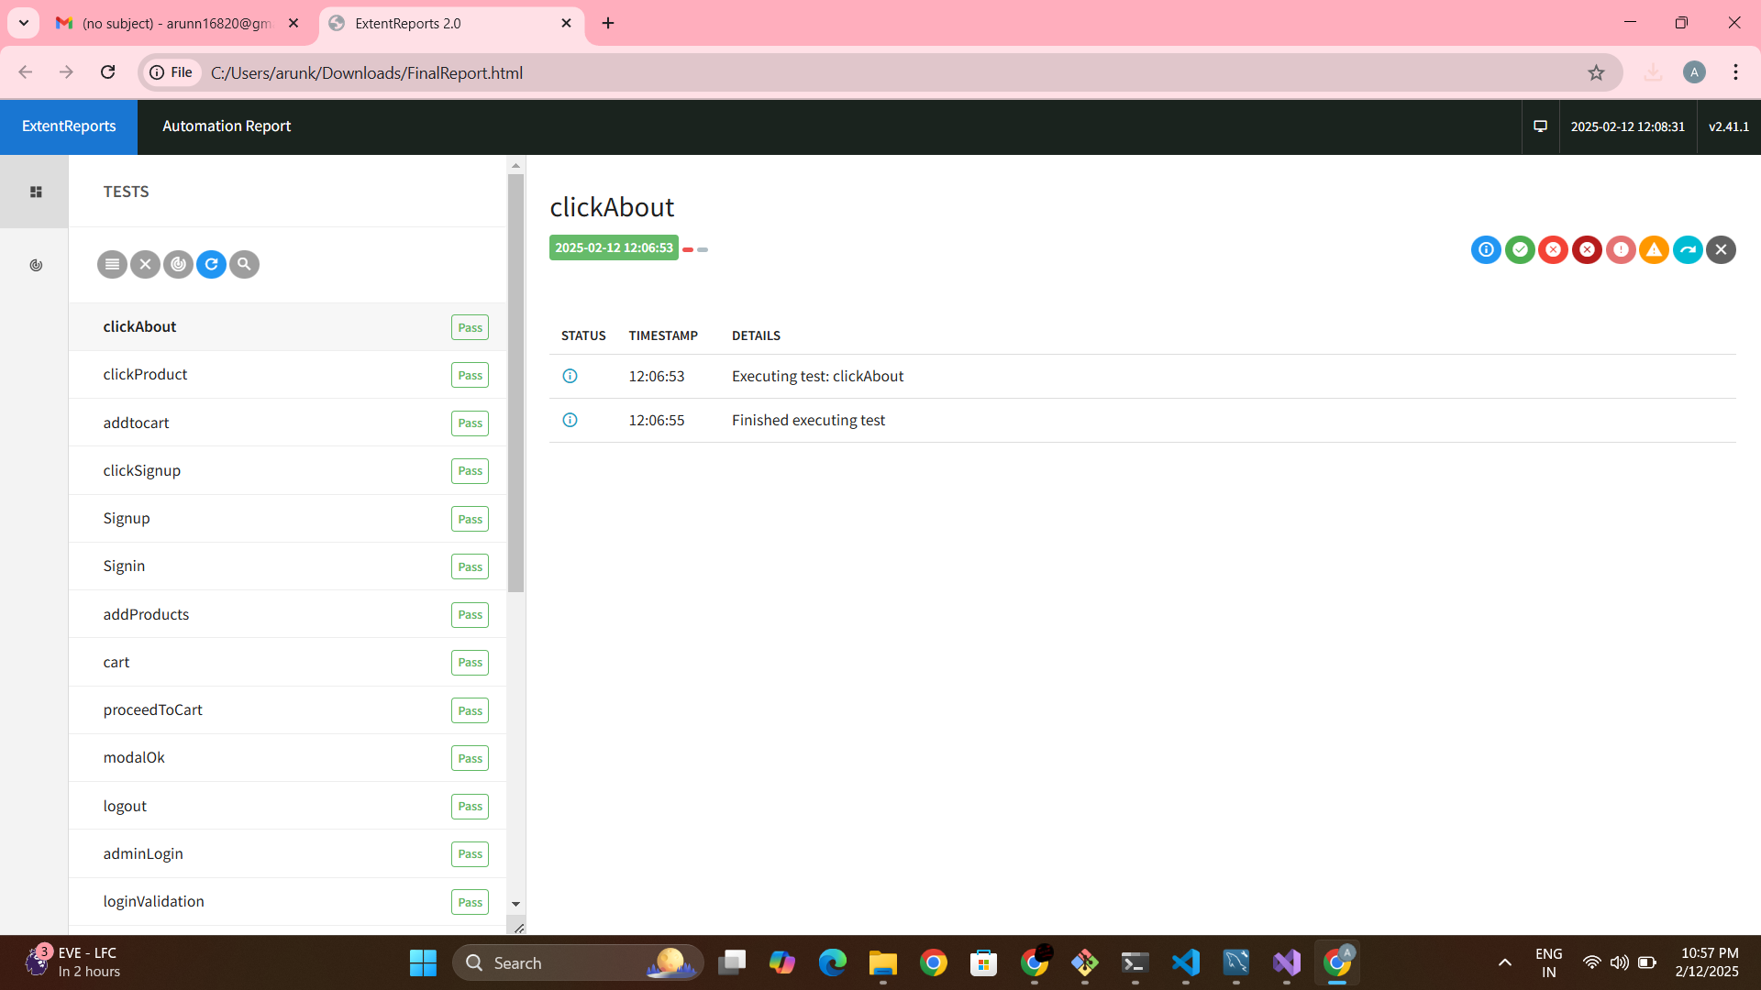
Extent Report

Slide 26
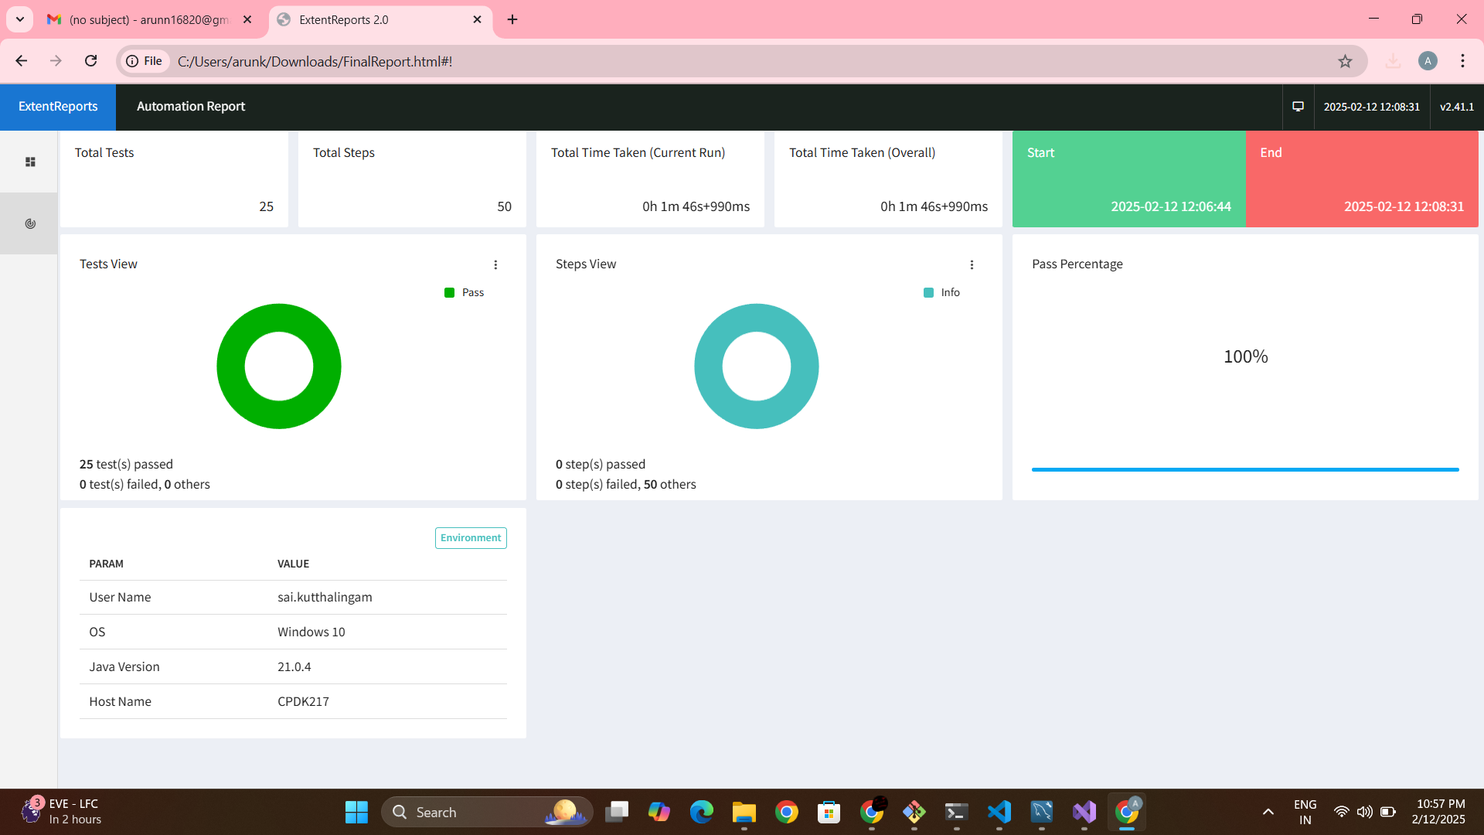

Slide 27
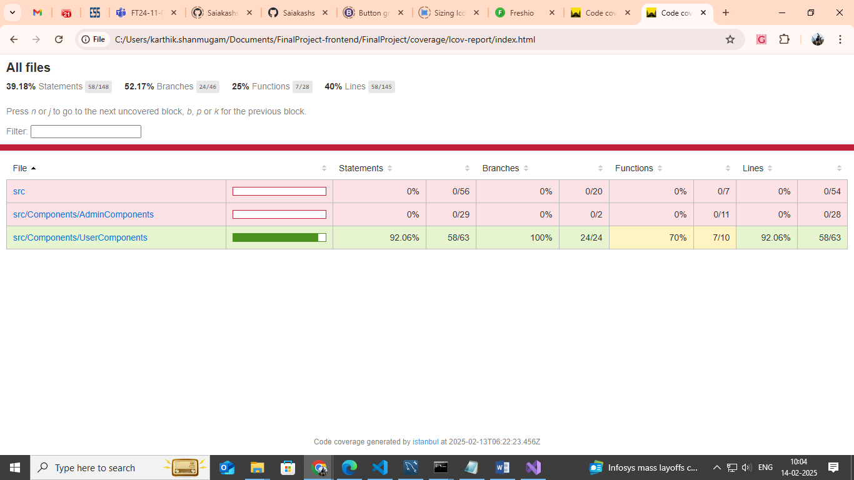
UNIT TESTING

Slide 28
Future Plans
1. Integration of Payment Gateway
Enable secure online payments (Credit/Debit cards, UPI, Net Banking, etc.)
Ensure seamless checkout experience

Slide 29
THANK YOU

